Slide 1
Cyclistic Bike-share Analysis
Google Analytics Capstone
Obayomi Oluwadamilola
18/09/2023

Slide 2
Table of content
Scenario
Data validation
Analysis
Summary
Recommendatiom
Appendix

Slide 3
Scenario
I am a junior data analyst working in the marketing analyst team at Cyclistic, a bike-share company in Chicago. The director of marketing believes the company’s future success depends on maximizing the number of annual memberships. Therefore, your team wants to understand how casual riders and annual members use Cyclistic bikes differently.

Slide 4
Data Validation
The data is unbiased and credible since it is an internal data. The data has no privacy issue. A 12 month historical data was used to analyse and study trends in Cyclistic.
R Studio and Tableau were used for this analysis.

Slide 5
Analysis
How do annual members and casual riders use Cyclistic bike differently?
Why would casual riders buy Cyclistic annual member?
How can Cyclistic use digital media to influence casual riders to become members?

Slide 6
Analysis
Total Rides
Average Ride Duration
5,722,891
Total ride from August 2022 - July 2023
1102sec (18mins 4secs)
On average a customer goes on a 18min 4sec ride.

Slide 7
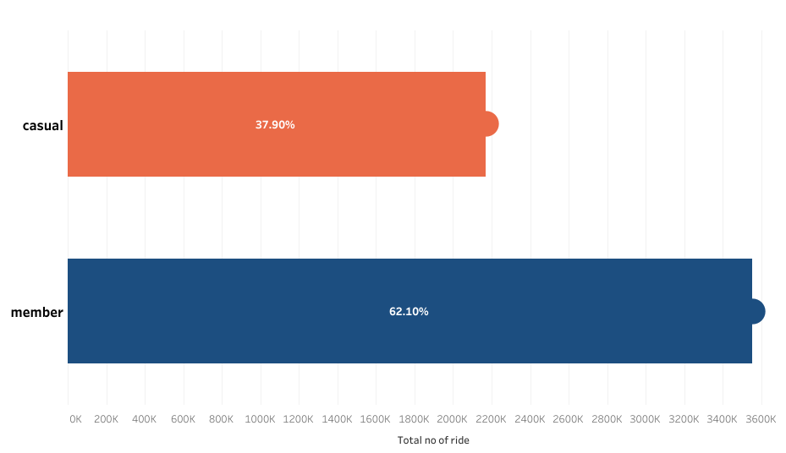
Total Ride
Members have the highest Percentage of Ride

Slide 8
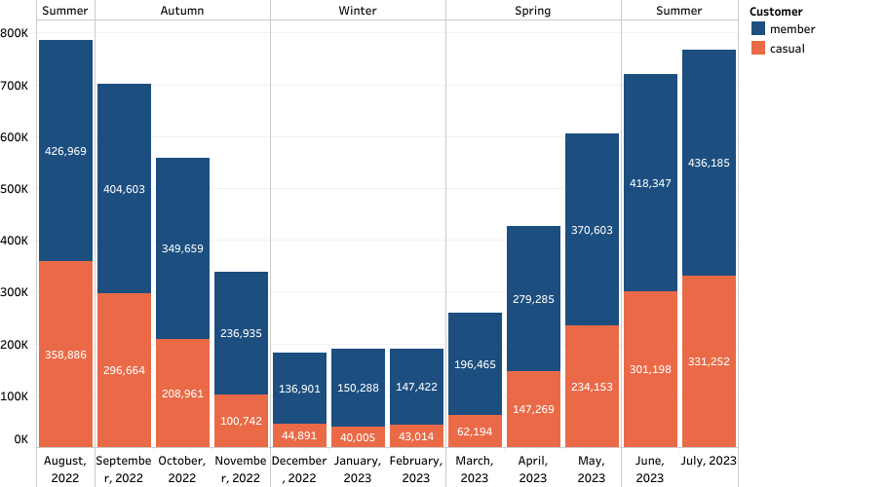
No of Ride by month
Total number of ride is at it’s peak in the Summer.
Total number of ride falls in Autumn and rise at Spring.
Total number of ride is at its lowest in winter

Slide 9
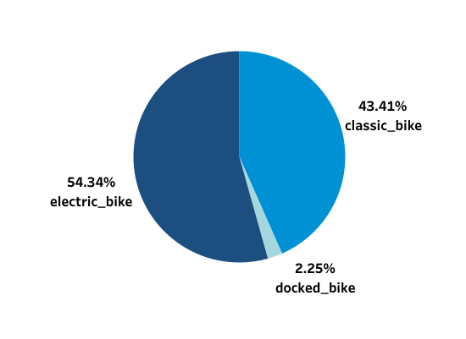
Bike Type
Customers use Electric and Classic bikes more than Docked bikes.

Slide 10
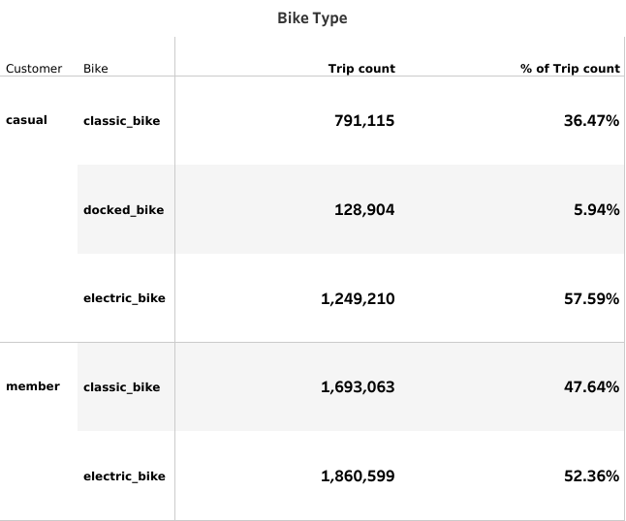
Bike Type
Only casuals use docked bike.
Electric is the most used bike for both customer.

Slide 11
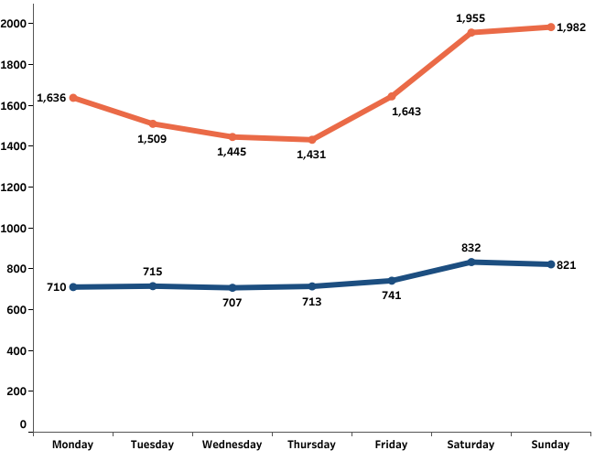
Average ride duration by Days of the week
In a week casuals go on longer ride than members.
Ride duration is steady across the week for members.
Casuals go on longer ride on Saturday & Sunday.

Slide 12
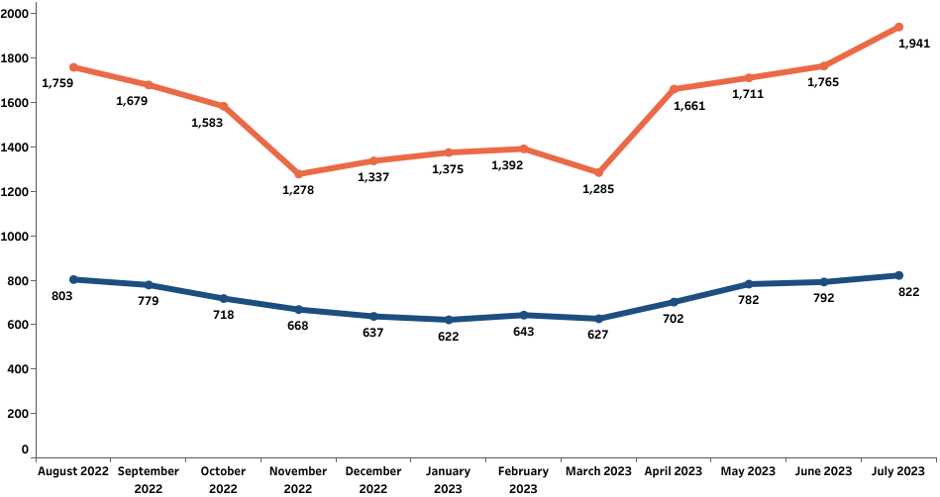
Average ride duration by month
Member ride duration is steady across the year, having its peak in July and August.
Casual go on their longest rides from April to October, having its peak in July and June.

Slide 13
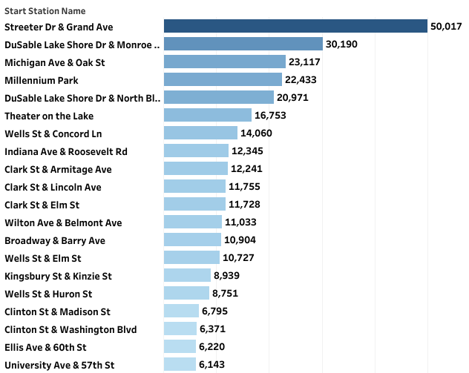
Top 20 start stations used by casuals

Slide 14
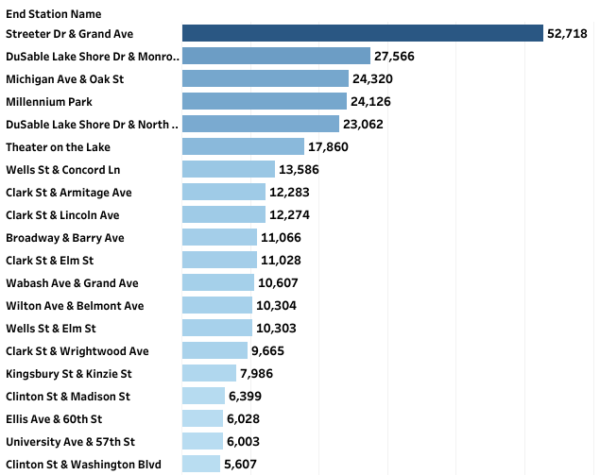
Top 20 end stations used by casuals

Slide 15
Summary
Casual have less rides but longer ride duration, this could be as a result of casuals riding for leisure and members to commute to work each day.
Both customers use Electric bike than other bikes.
Longer rides are taken on weekend.
Most active months of the year is May to October.

Slide 16
Recommendation
Create special 6 month package leaning towards membership plan from May to October.
Discounts on annual membership plan to casual riders with longer rides duration.
Awards or Prizes on longer rides available to only Cyclistic annual members.
The campaign should be targeted at casuals most used start and end stations. It will be most effective during May to October from Fridays to Saturdays.

Slide 17
Thank You
Any questions? Contact ;
obayomipaul01@gmail.com
https://www.linkedin.com/in/oluwadamilola-obayomi-03a16823a/

Slide 18
Appendix
Dashboard link:
Analysis 1
https://public.tableau.com/views/Tripdatacleaned/Analysis1?:language=en-US&:display_count=n&:origin=viz_share_link
Analysis 2
https://public.tableau.com/views/Tripdatacleaned/Analysis2?:language=en-US&:display_count=n&:origin=viz_share_link

